Slide 1

Introduction to Software Quality Assurance and Control

Slide 2

Importance of Software Quality
1
User Satisfaction
2
Business Success
High-quality software delights users with seamless performance, intuitive interfaces, and reliability.
Robust software contributes to brand reputation, customer loyalty, and overall business growth.
3
Cost Reduction
4
Reduced Risks
Early identification and prevention of defects save time, resources, and costly rework.
Thorough quality assurance minimizes potential security vulnerabilities, system crashes, and data loss.

Slide 3
Software Quality Assurance (SQA) Principles
Prevention over Detection
Continuous Improvement
Customer Focus
Emphasize proactive measures to prevent defects from occurring in the first place.
Embrace a culture of ongoing refinement, analysis, and optimization of quality processes.
Align quality efforts with user needs and expectations for a positive user experience.

Slide 4

Software Quality Control (SQC) Techniques
1
Code Reviews
Systematic examination of code for adherence to standards, best practices, and potential defects.
2
Static Analysis
Automated tools that scan code for potential issues without executing the software.
3
Dynamic Testing
Testing that involves executing the software to evaluate its functionality and performance.
4
Regression Testing
Verifying that changes to the software have not introduced new defects or regressions.

Slide 5
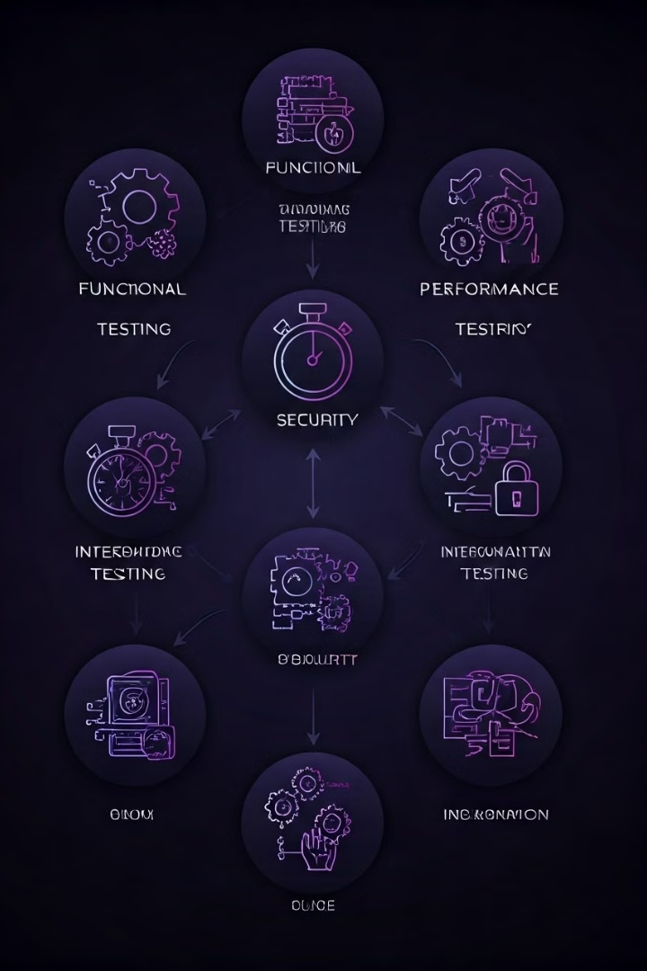
Testing Methodologies and Approaches
Black Box Testing
White Box Testing
Testing based on functional specifications without knowledge of internal code structure.
Testing that focuses on internal code structure, logic, and paths to ensure code quality.
Grey Box Testing
A combination of black box and white box testing, using limited access to internal code.

Slide 6






Quality Assurance in the Software Development Life Cycle
Requirements Gathering
Ensuring that quality attributes are defined and incorporated from the start.
Design
Reviewing designs for adherence to quality standards and best practices.
Coding
Applying code reviews, static analysis, and unit testing to identify and prevent defects.
Testing
Conducting a comprehensive suite of tests to validate functionality, performance, security, and usability.
Deployment
Verifying the quality of the deployed software and monitoring performance in production.
Maintenance
Performing regular updates, bug fixes, and enhancements to maintain software quality over time.

Slide 7
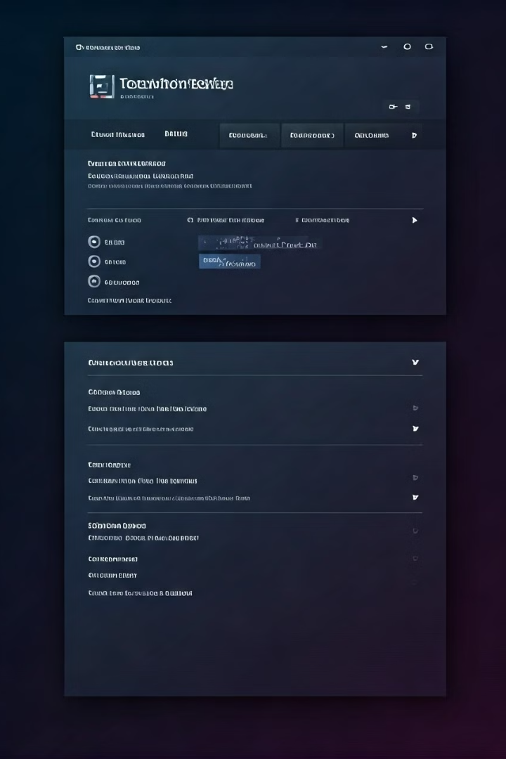




Tools and Automation for Quality Assurance
Bug Tracking
Test Automation
Tools for managing and tracking defects discovered during testing.
Software that automates repetitive testing tasks for efficiency and coverage.
Performance Testing Tools
Security Testing Tools
Tools to measure and analyze software performance under various load and stress conditions.
Specialized tools to identify and assess vulnerabilities in software systems.

Slide 8

Challenges and Best Practices in SQA
Challenge
Best Practice
Time Constraints
Prioritize testing based on risk and impact.
Limited Resources
Optimize test automation and leverage open-source tools.
Changing Requirements
Implement agile testing practices and adapt quickly to changes.
Complexity of Software
Break down testing into manageable units and focus on key areas.

